Slide 1
ADO.NET: The Entity Framework
Ronnie Holm
Lecture 8

Slide 2
Agenda
Introduction to Entity Framework
The core collection interfaces
Interpreted queries
Building query expressions

Slide 3
Introduction to EF
A full-blown object-relational mapper (ORM)
Attempts to bridge impedance mismatch between OO and relational domain
Allows interaction with RDBMS using object model that maps to business objects in app
Database first vs. code first
Notes:
- LINQ provides multiple symmetric architectures - Local queries for local object collections - Interpreted queries for remote data sources

Slide 4
Introduction to EF (2)
The EDMX XML models are required to map between database fields and class properties
Conceptual (model as perceived by application)
Logical (mapping between physical/conceptual)
Physical (description of real database entities)
Entity designer will generate C# classes that maps to the conceptual model

Slide 5
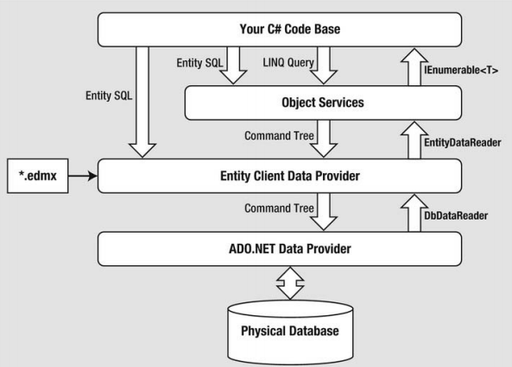
Introduction to EF (3)
From C# LINQ query to database and back

Slide 6
The core collection interfaces
Many different kinds of collection exists, each with different internal implementations and external characteristics
Ability to traverse contents of collection is an almost universal need
Framework exposes common traversal API through the IEnumerable/IEnumerator interfaces
IEnumerable
IEnumerator
Enumerable
IEnumerable<T>
IEnumerator<T>
Queryable
IQueryable<T>

Slide 7
IEnumerable/IEnumerator interface
Defines basic low-level protocol by which collection elements are traversed in a read-only, forward-only manner
public interface IEnumerable {
IEnumerator GetEnumerator();
}
static void Main(string[] args) { // String class implements IEnumerable
string s = "Hello";
IEnumerator e = s.GetEnumerator();
while (e.MoveNext()) {
char c = (char)e.Current;
Console.WriteLine(c);
}
// or using syntactic shortcut
foreach (char c in s) {
Console.WriteLine(c);
}
}
public interface IEnumerator {
bool MoveNext();
object Current { get; }
void Reset();
}
IEnumerable
IEnumerator
Notes:
- Collections don’t implement an IEnumerator - Instead they provide enumerators through the IEnumerable interface - By providing a single method returning an enumerator - Iteration logic can be farmed off to another class - Several consumers can enumerate the collection at once without interfering with each other

Slide 8
IEnumerable<T>/IEnumerator<T> interface
Avoid overhead of boxing with value-type elements
static void Main(string[] args) {
List<int> n = new List<int> { 1, 2, 3 };
List<int>.Enumerator e =
n.GetEnumerator();
while (e.MoveNext()) {
int c = e.Current;
Console.WriteLine(c);
}
// or in short-hand // using (var e = n.GetEnumerator())
foreach (int c in n) {
Console.WriteLine(c);
}
}
public interface IEnumerable<T> :
IEnumerable {
IEnumerator<T> GetEnumerator();
}
public interface IEnumerator<T> :
IEnumerator, IDisposable {
T Current { get; }
}
public struct Enumerator :
IEnumerator<T>, IDisposable, IEnumerator
IEnumerable<T>
IEnumerator<T>
Notes:
- IEnumerator<T> inherits from IDisposable - Allows enumerators to hold references to resources such as database connections - Ensures resources are released when enumeration is complete - foreach statement recognizes this details and gets surrounded by using block - By defining a typed version of GetEnumerator and Current - Interfaces strengthen static type safety - Remedies the unboxing and type casting issues with object

Slide 9
IEnumerable<T> extension methods
Added to current context through using statement
Adds methods to every instance of type that implements IEnumerable<T>
Extension methods typically require only an iteration protocol in order to work
public static class Enumerable {
public static IEnumerable<TSource> Where<TSource>(
this IEnumerable<TSource> source,
Func<TSource, bool> predicate) {
foreach (TSource element in source) {
if (predicate(element))
yield return element;
}
}
}
Enumerable
IEnumerable<T>

Slide 10
Interpreted queries
Interpreted queries operate over sequences that implement IQueryable<T>
Resolves to query operators in the Queryable class, which emit expression trees that are interpreted at runtime
Two IQueryable<T> implementation ship with .NET
LINQ to SQL
LINQ to Entities

Slide 11
Interpreted queries (2)
Transforming from LINQ to SQL
static void Main(string[] args) {
// LINQ to SQL DataContext. LINQ to Entities works similarly
// DataContext dc = new DataContext("connection string"); // Table<T> implements IQueryable<T>
// Table<Customer> customers = dc.GetTable<Customer>();
IQueryable<string> query = customers
.Where(n => n.Name.Contains("a"))
.OrderBy(n => n.Name.Length)
.Select(n => n.Name.ToUpper());
foreach (string name in query) {
Console.WriteLine(name);
}
}
SELECT UPPER([t0].[Name]) AS [value]
FROM [Customer] AS [t0]
WHERE [t0].[Name] LIKE @p0
ORDER BY LEN([t0].[Name])
Notes:
- Because IQueryable<T> is a subtype of IEnumerable<T>, the compiler has a choice in resolving Where - Call the extension method in IEnumerable<T> or the one in IQueryable<T>? - Compiler chooses IQueryable<T> because its signature is more specific match - When you enumerate over an interpreted query, then - The outermost sequence runs a program that traverses the entire expression tree and processes it - In this example LINQ to SQL translates expression tree to SQL statement - SQL statement executes, yielding the result as a sequence - For the translation from expression tree to SQL, LINQ to SQL needs some clues as to schema of the database - Table and Column attributes applied to the Customer class serve this function

Slide 12
IQueryable<T> extension methods
public static class Enumerable { public static IEnumerable<TSource> Where<TSource>(
this IEnumerable<TSource> source,
Func<TSource, bool> predicate) { … }
}
public static class Queryable { public static IQueryable<TSource> Where<TSource>(
this IQueryable<TSource> source,
Expression<Func<TSource, bool>> predicate) { … }
}
Instructs compiler to translate supplied lambda expression to an expression tree rather than a compiled delegate.
An expression tree is an object model that can be inspected
at runtime so that LINQ to SQL or LINQ to EF can later translate it into a SQL statement.
Queryable
IQueryable<T>
Notes:
- Because IQueryable.Where also returns IQueryable<T>, the same process follows with OrderBy and Select - The end result is an expression tree describing entire query, which can be traversed at runtime - The benefit of having a standard set of methods in Queryable is that - They define a standard vocabulary for querying any remote collection - An IQueryable provider may be unable to cope with some queries - LINQ to SQL and LINQ to EF are both limited by the capabilities of the database server - Some LINQ queries have no SQL translation which causes a runtime error

Slide 13
Building query expressions
Implicit conversion from lambda expression to Expression<TDelegate> causes C# compiler to emit code that builds an expression tree
static void Main(string[] args) {
IEnumerable<Product> q1 = localProducts.Where(p => !p.Discontinued);
IQueryable<Product> q2 = sqlProducts.Where (p => !p.Discontinued);
// when assigning lambda expression to intermediate // variable you must be explicit
Func<Product, bool> predicate1 = p => !p.Discontinued;
IEnumerable<Product> q3 = localProducts.Where(predicate1);
Expression<Func<Product, bool>> predicate2 = p => !p.Discontinued;
IQueryable<Product> q4 = sqlProducts.Where(predicate2);
}

Slide 14
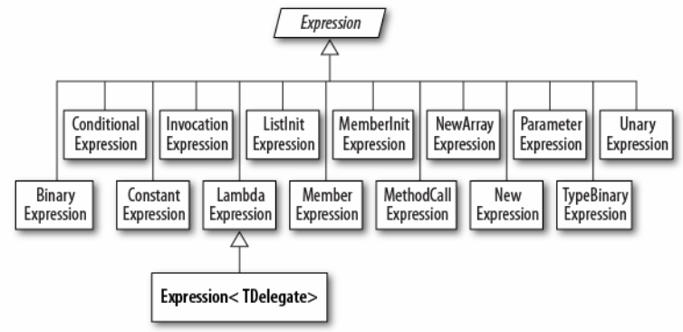
Building query expressions (2)
Expression tree is a miniature code DOM
Means “typed lambda expression”. Might
have been named LambdaExpression<TDelegate>
if it didn’t take so many characters to type.

Slide 15
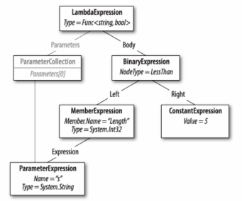
Building query expressions (3)
Expression<Func<string, bool>> f = s => s.Length < 5;
Console.WriteLine(f.Body.NodeType); // LessThan
Console.WriteLine(((BinaryExpression)f.Body).Right); // 5
Notes:
- Install VS debug visualizer for expression trees

